Slide 1


Slide 2
UNDER THE GUIDELENES : Varun Sir and Ramya Mam
GROUP MEMBERS:
1)Mr. Vijay Ganpat Rathod
2)Mr. Samit Nandhi
3)Ms. Sunitha R
4)Ms. Swati
5)Ms. Payal Kasera

Slide 3
Business Objective:
Customer churn is a big problem for telecommunications companies. Indeed, their annual churn rates are usually higher than 10%. For that reason, they develop strategies to keep as many clients as possible. This is a classification project since the variable to be predicted is binary (churn or loyal customer). The goal here is to model churn probability, conditioned on the customer features.

Slide 4

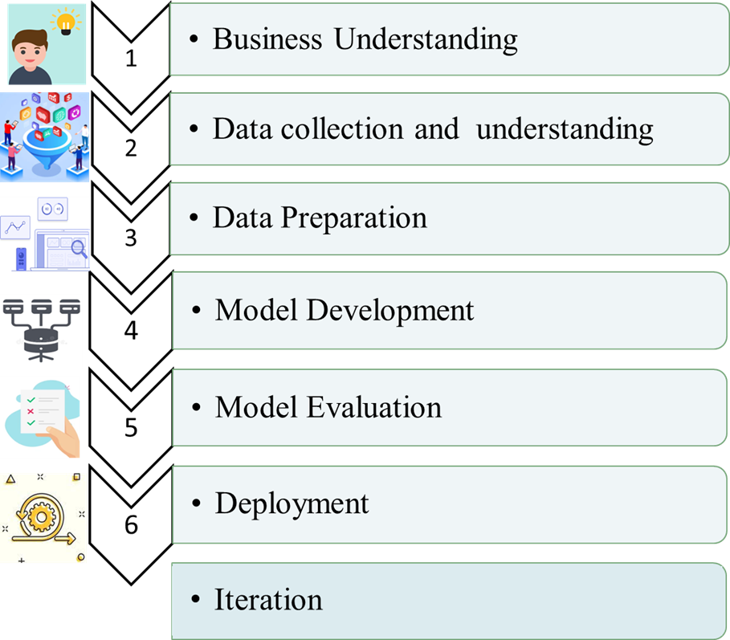



Slide 5


Slide 6

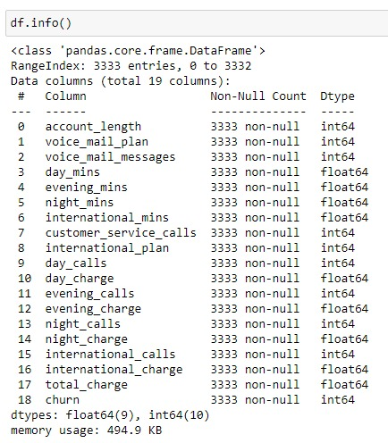

Slide 7
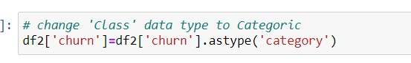
Convert churn data type to category from int64

Slide 8


Slide 9
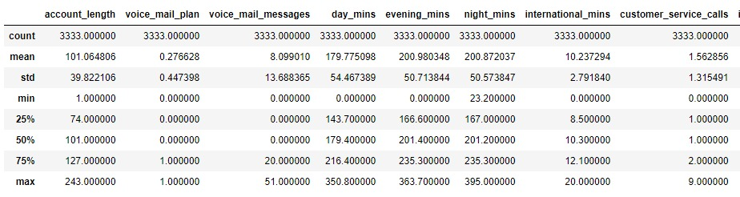
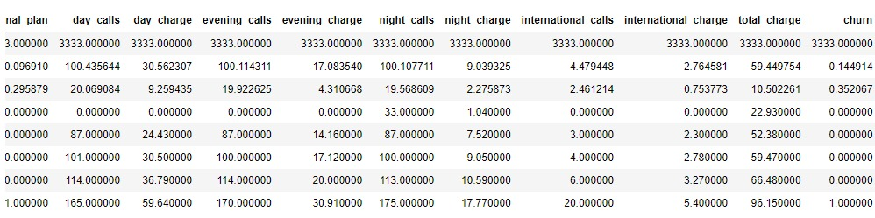

Slide 10
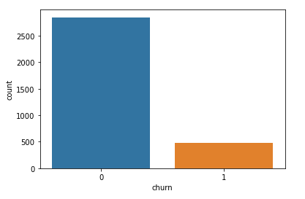
Count plot for Churn:
After analyzing the churn column, we had little to say like almost 15% of customers have churned. let's see what other features say to us and what relation we get after correlated with churn

Slide 11

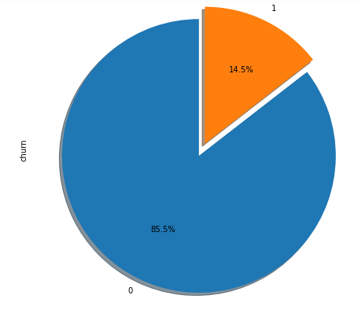

Slide 12
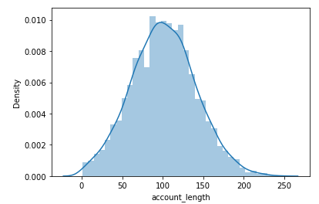
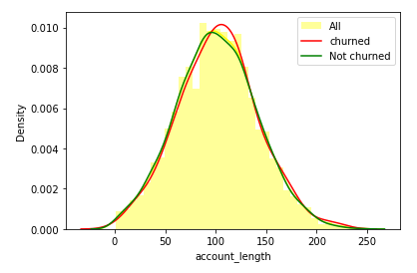
Plot for column Account Length:
After analyzing various aspects of the "account length" column we didn't found any useful relation to churn. so we aren't able to build any connection to the churn as of now.

Slide 13
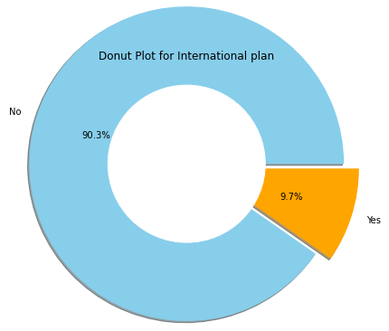
Plot’s for International Plan column:

Slide 14
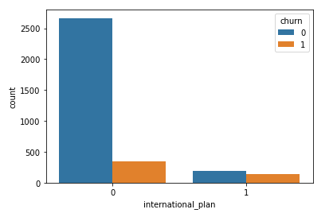
From the above data we get¶
There are 3010 customers who dont have a international plan.
There are 323 customers who have a international plan.
Among those who have a international plan 42.4 % people churn.
Whereas among those who dont have a international plan only 11.4 % people churn.
So basically the people who bought International plans are churning in big numbers.
Probably because of connectivity issues or high call charge

Slide 15
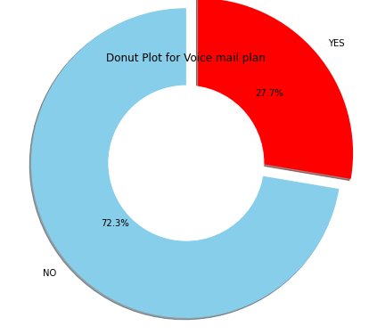
Plot’s for Voice Mail Plan column:

Slide 16
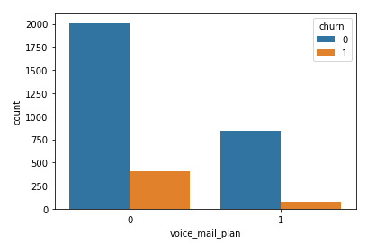
As we can see there is are no clear relation between voice mail plan and churn so we can't clearly say anything so let's move to the next voice mail feature i.e number of voice mail, let's see what it gives to us

Slide 17
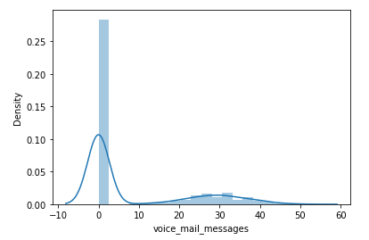
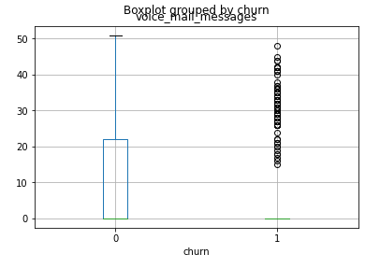
Plot’s For Number voice mail messages:
After analyzing the above voice mail feature data we get an insight that when there are more than 20 voice-mail messages then there is a churn
For that, we need to improve the voice mail quality

Slide 18
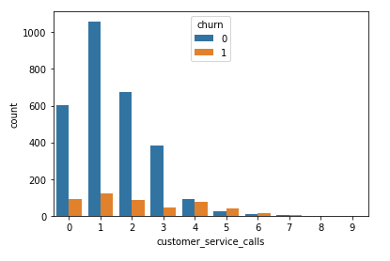
Plot’s For Customer service calls:

Slide 19
It is observed from the above analysis that, mostly because of bad customer service, people tend to leave the operator.
The above data indicating that those customers who called the service center 5 times or above those customer churn percentage is higher than 60%,
And customers who have called once also have a high churn rate indicating their issue was not solved in the first attempt.
So operator should work to improve the service call

Slide 20
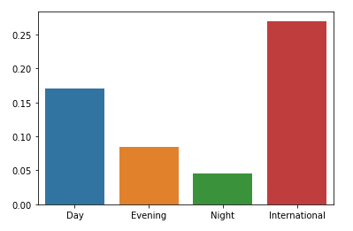
After analyzing the above dataset we have noticed that total day/night/eve minutes/call/charges are not put any kind of cause for churn rate. But international call charges are high as compare to others it's an obvious thing but that may be a cause for international plan customers to churn out

Slide 21
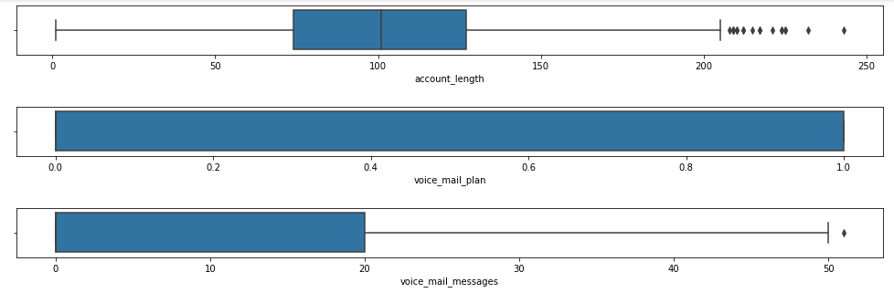
Box Plots For All the Columns:

Slide 22
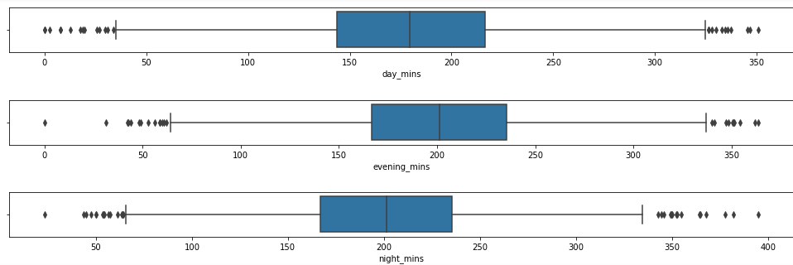
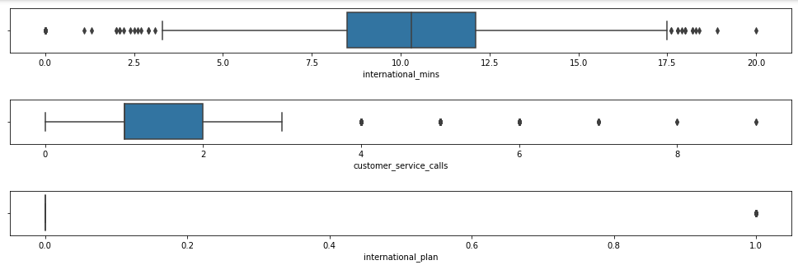

Slide 23
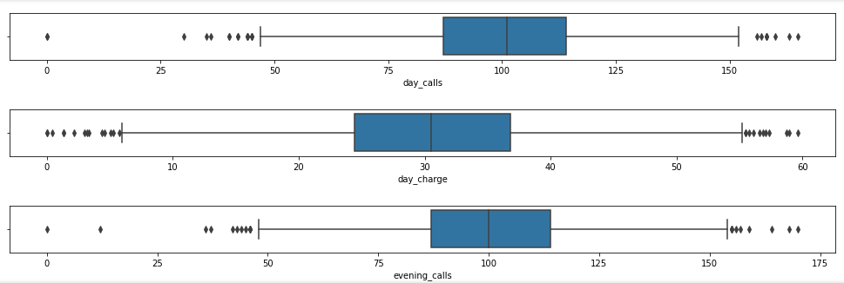
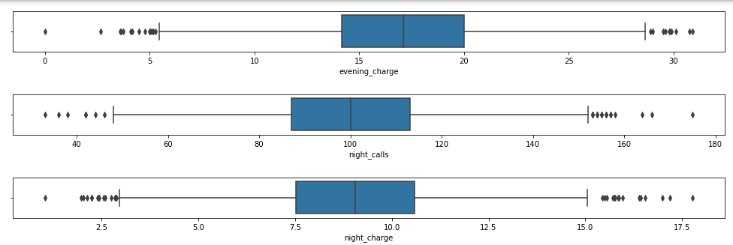

Slide 24
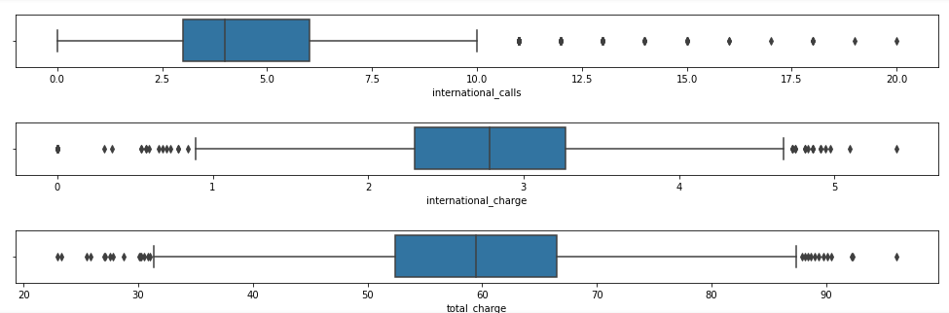

Slide 25
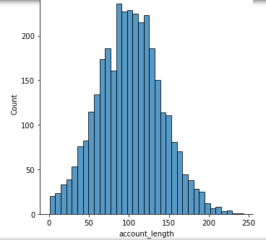
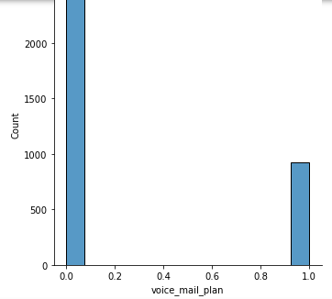
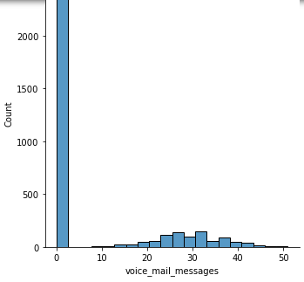
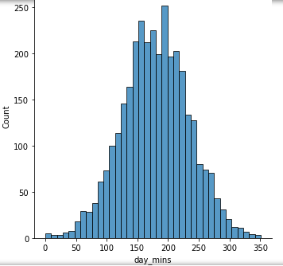
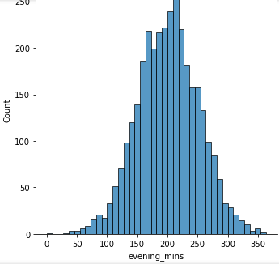
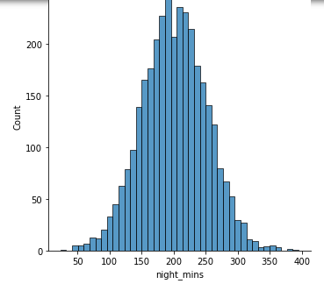

Slide 26
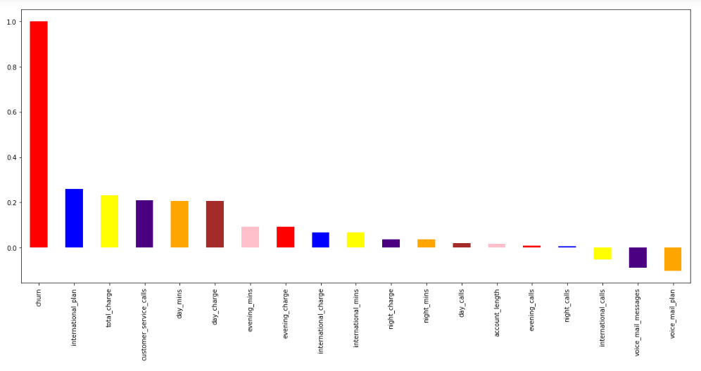
Correlation Plot:

Slide 27
Detecting and Treating Outliers
A critical part of the EDA is the detection and treatment of outliers. Outliers are observations that deviate strongly from the other data points in a random sample of a population.

Slide 28
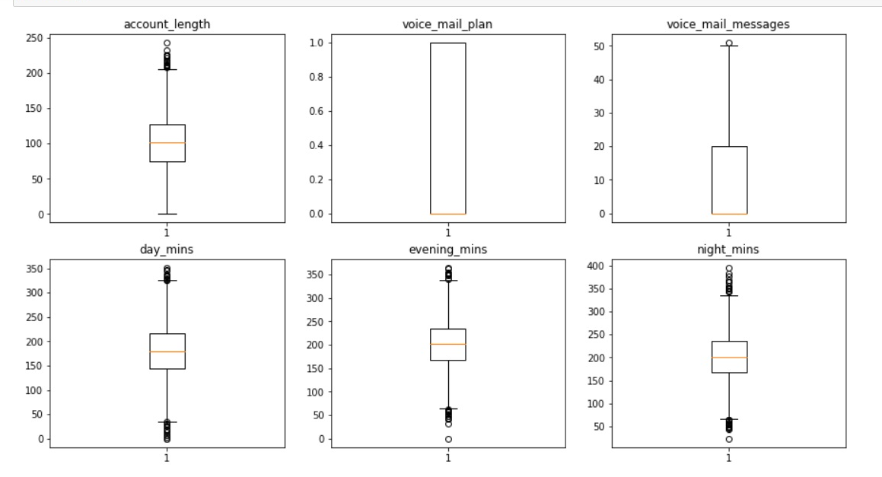
DETECTING OUTLIERS

Slide 29
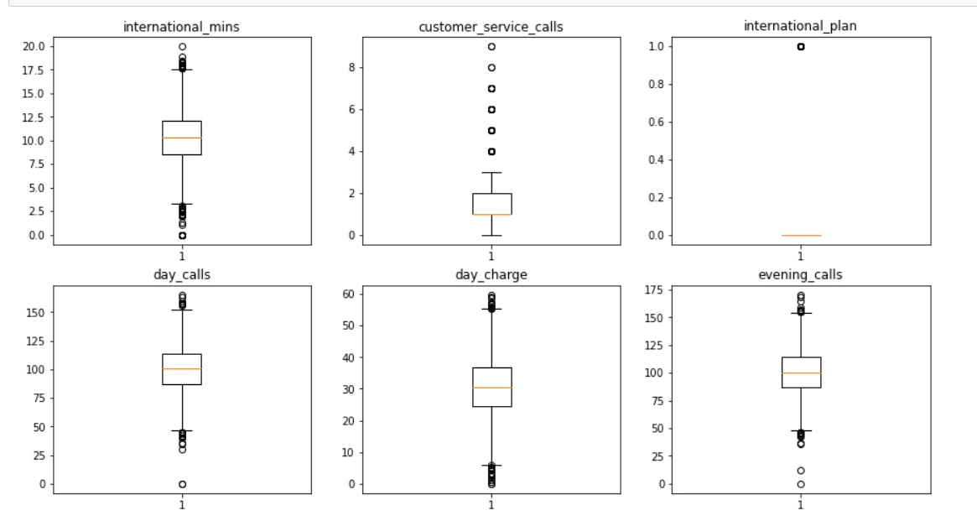

Slide 30
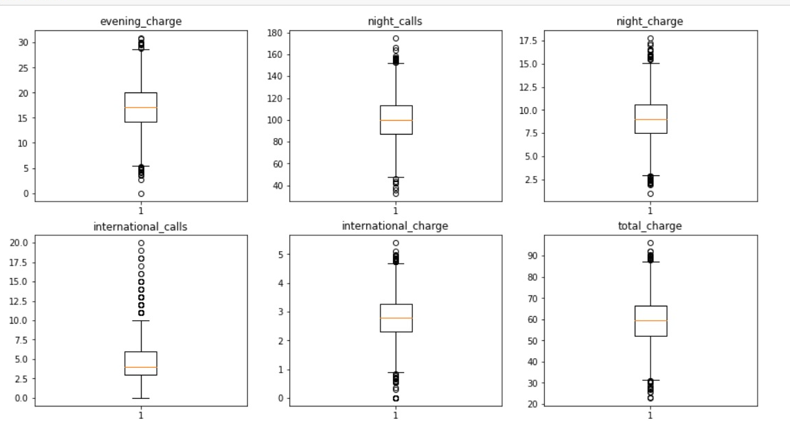

Slide 31
TREATING OUTLIERS
Winsorization is a way to minimize the influence of outliers in your data by either:
Assigning the outlier a lower weight,
Changing the value so that it is close to other values in the set.
The data points are modified, not trimmed/removed (as in the trimmed mean).

Slide 32
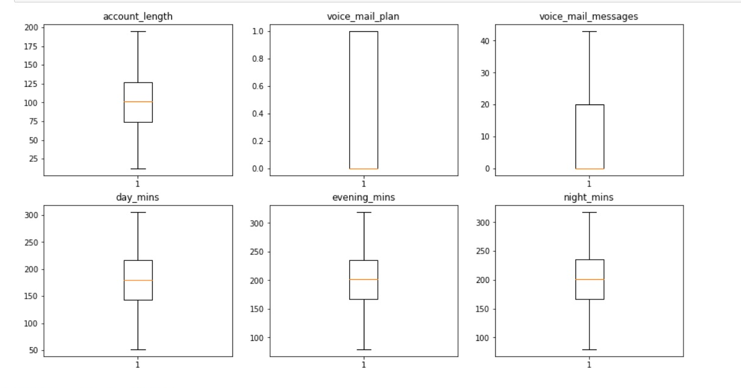

Slide 33


Slide 34
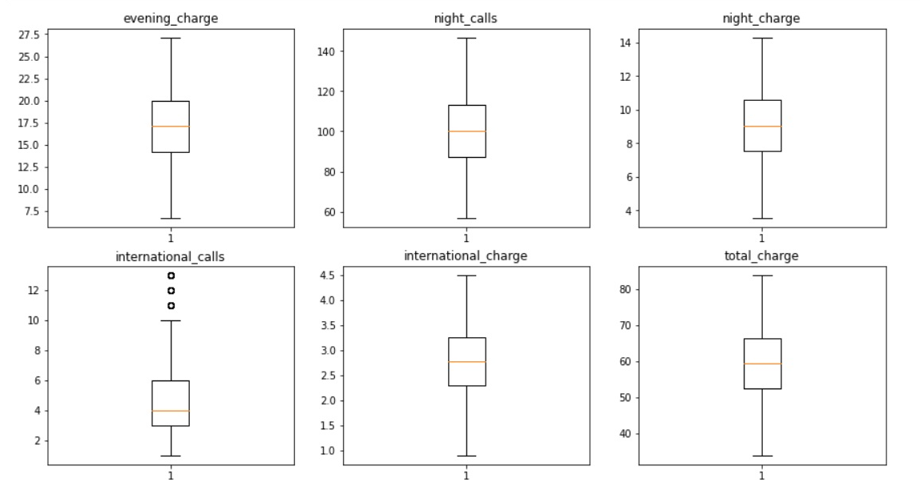

Slide 35
Feature Engineering
Recursive Feature Elimination.
Correlation Matrix.
Correlation Heat Map.

Slide 36
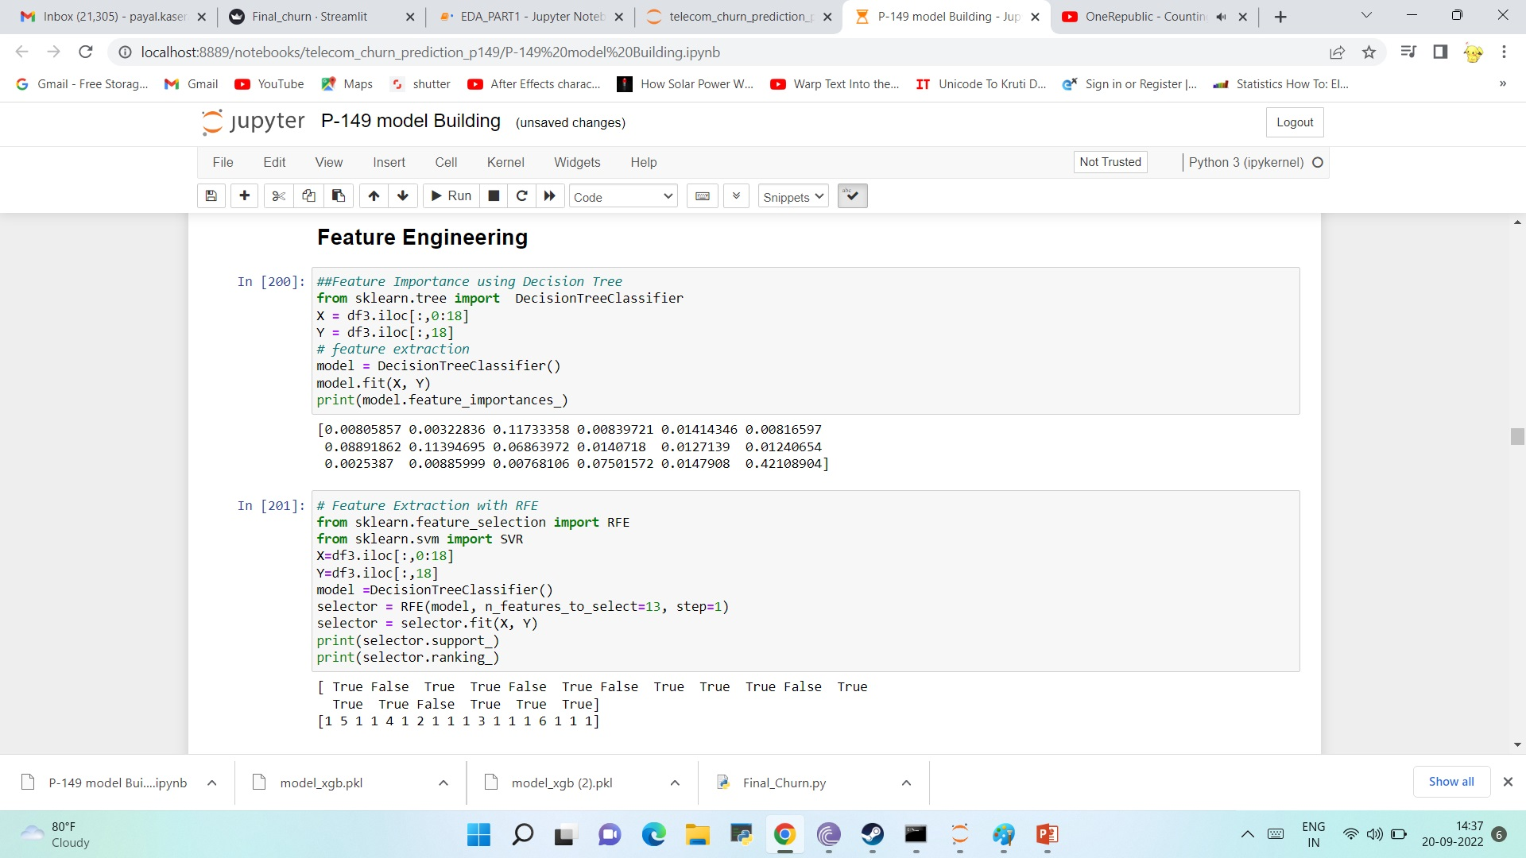
Recursive Feature Elimination.
RFE is renowned because it is easy to plan and use and in light of the fact that it is convincing at picking those features (segments) in a readiness dataset that are more or most relevant in predicting the objective variable.

Slide 37
Correlation Matrix.
A correlation matrix is a table showing relationship coefficients between factors. Every cell in the table shows the relationship between's two factors. A connection framework is utilized to sum up information, as a contribution to a further developed investigation, and as an indicative for cutting edge examinations.

Slide 38
Correlation Heat Map.
Correlation heatmaps are a sort of plot that imagine the strength of Correlation between numerical variables. Correlation plots are used to fathom which elements are Correlation with each other and the strength of this relationship. An Correlation plot consistently contains different numerical elements, with each factor tended to by a part.

Slide 39
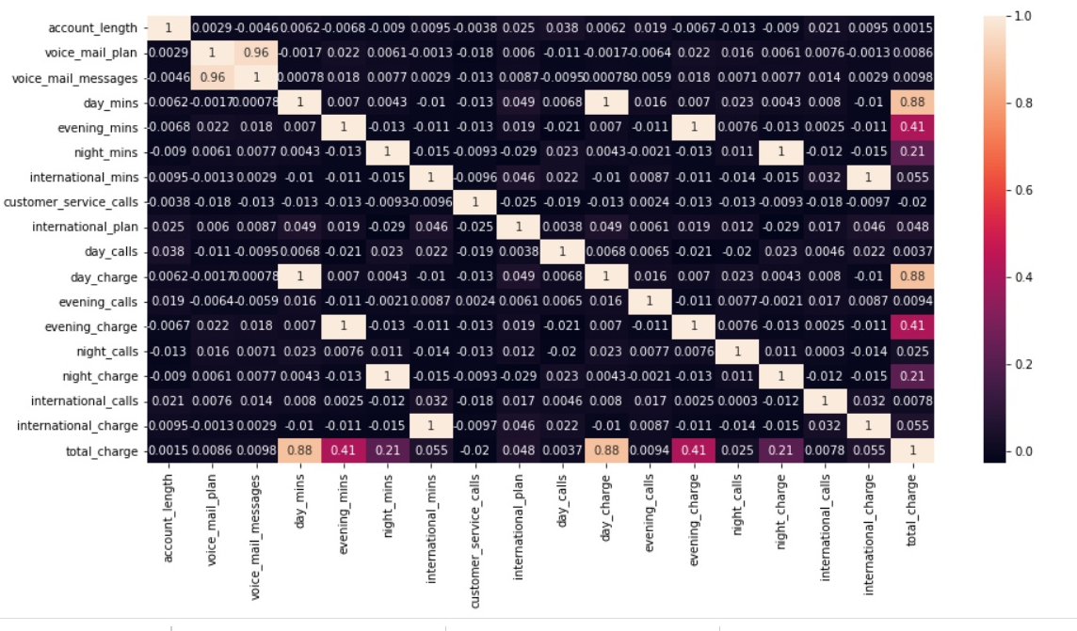
Correlation Matrix And Heat Map.

Slide 40
Correlation Matrix And Heat Map.
Highly Correlated Variables
voice_mail_messages And voice_mail_plan.
day_mins And day_charge.
evening_mins And evening_charge.
Night_mins And night_charge.
Total_charge And day_mins.

Slide 41
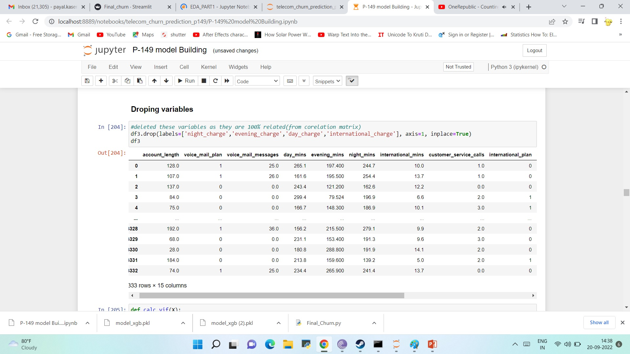
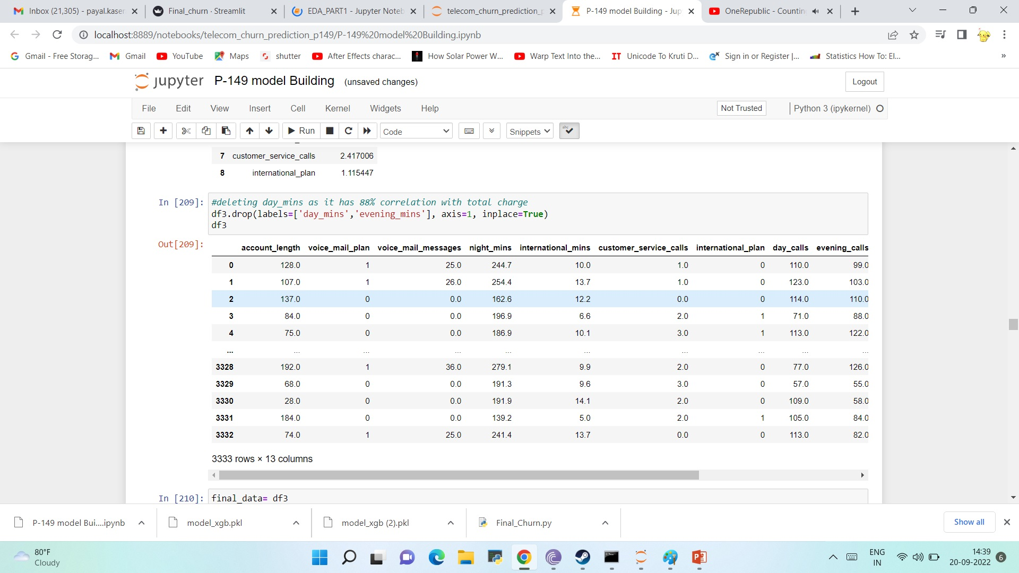
Droping variables
We have to drop Following Variables because they have multicollinearity with other variables and hence they will be indirectly influence other varibles and Accuracy of our will also get influenced by them.
night_charge
evening_charge
day_charge
international_charge
day_mins
evening_mins

Slide 42

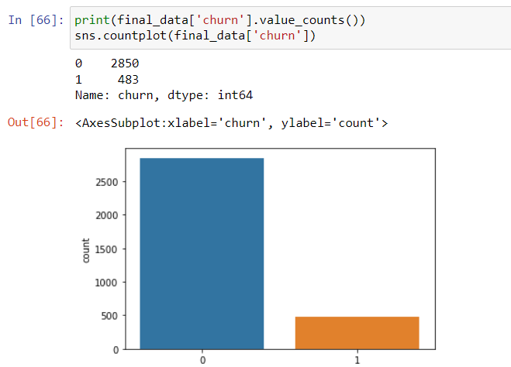

Checking Balancing the data set
As we can there is inbalancing the in data which will directly Affect on Model Accuracy .

Slide 43
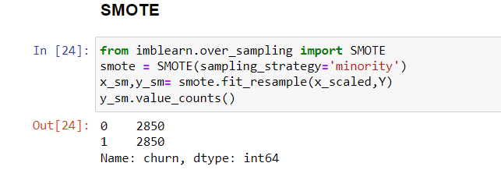
Balancing the dataset
SMOTE represents Synthetic Minority Oversampling Technique. This is a factual strategy for expanding the quantity of cases in your dataset in a decent way. The module works by producing new examples from existing minority cases that you supply as info. This execution of SMOTE doesn't change the quantity of greater part cases.

Slide 44

Model Building
Random Forest.
KNN.
Bagging.
AdaBoost.
Decision Tree.
XG- Boost.
Logistic Regression.

Slide 45
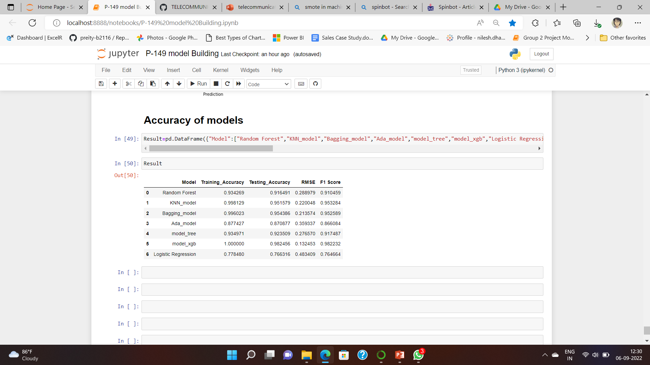

Accuracy Score of Models
We get the Highest Accuracy in XG-Boost model with 100% in Training And 98.24% in Test

Slide 46
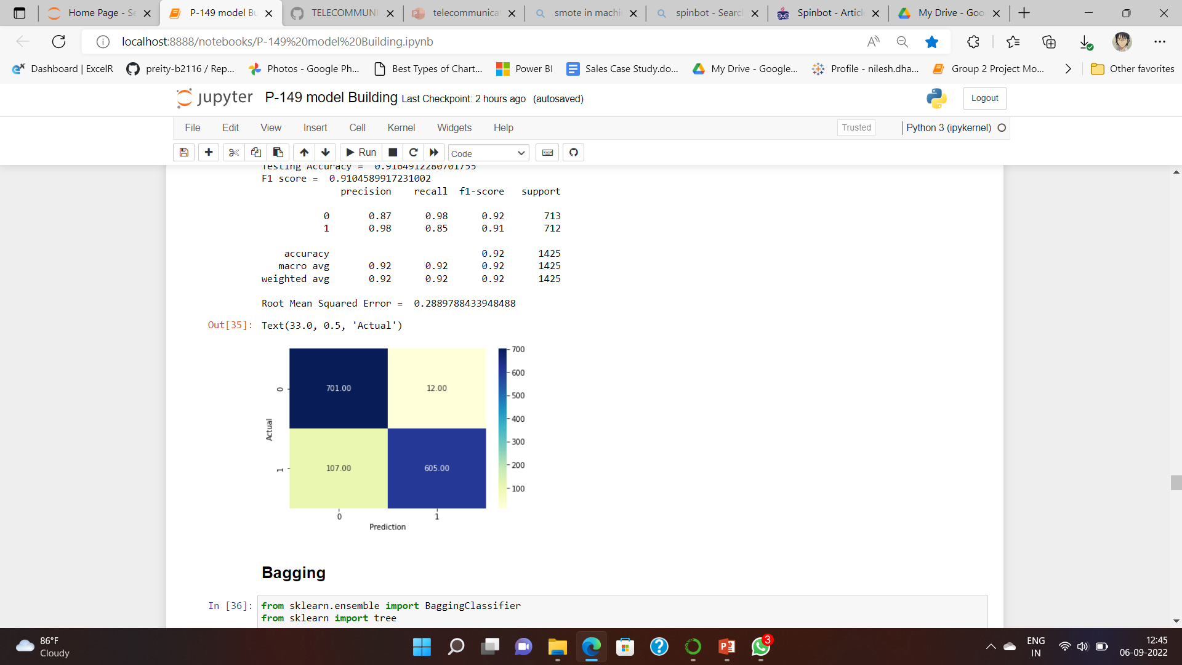
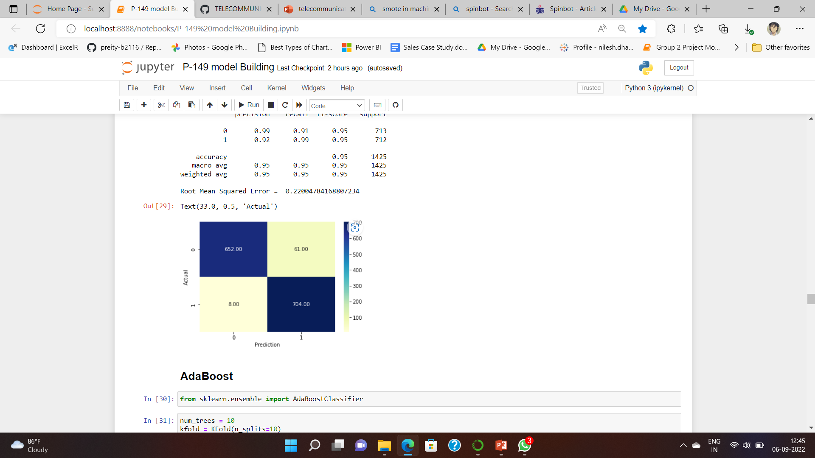
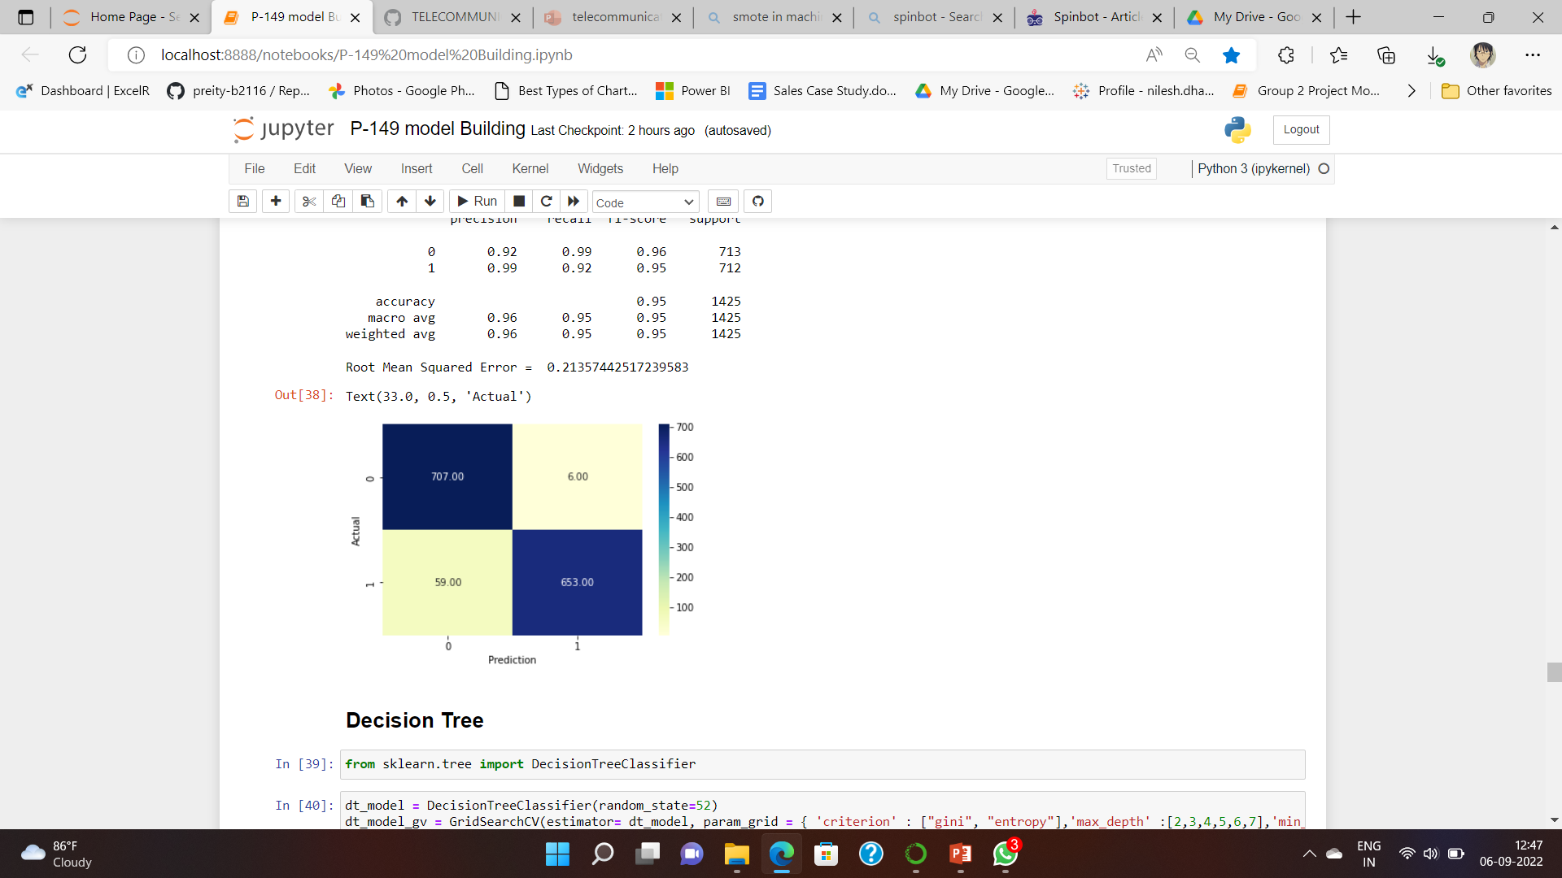
Confusion matrix of Models
Random Forest
KNN
Bagging

Slide 47
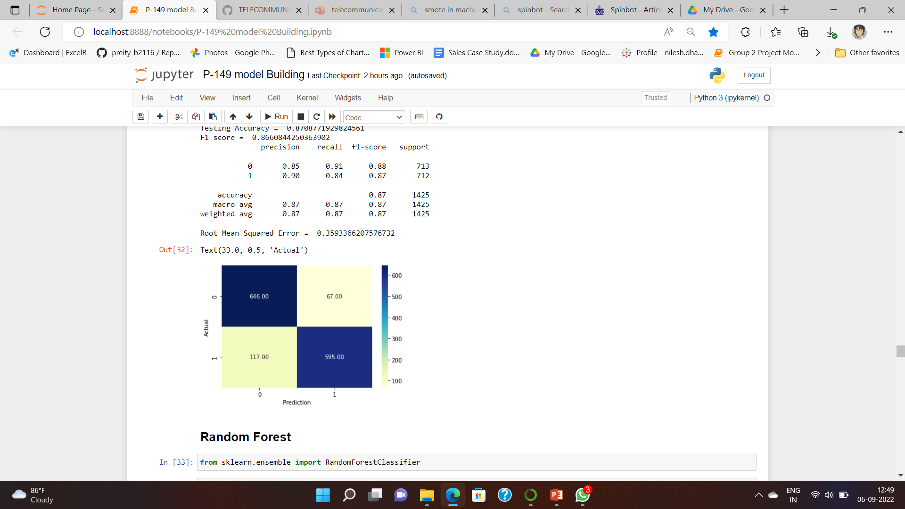
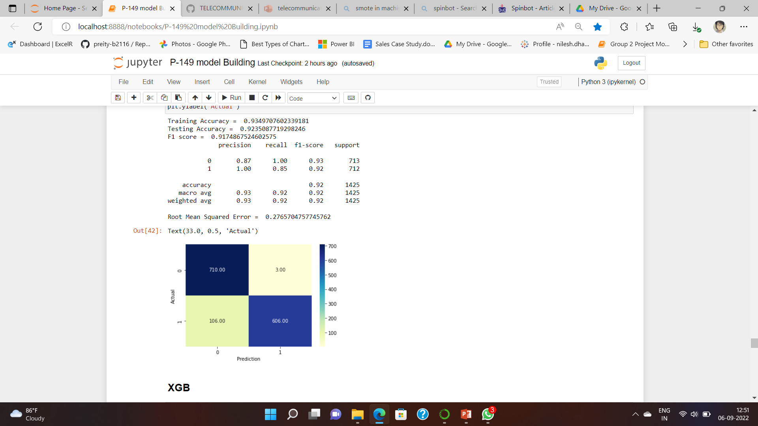
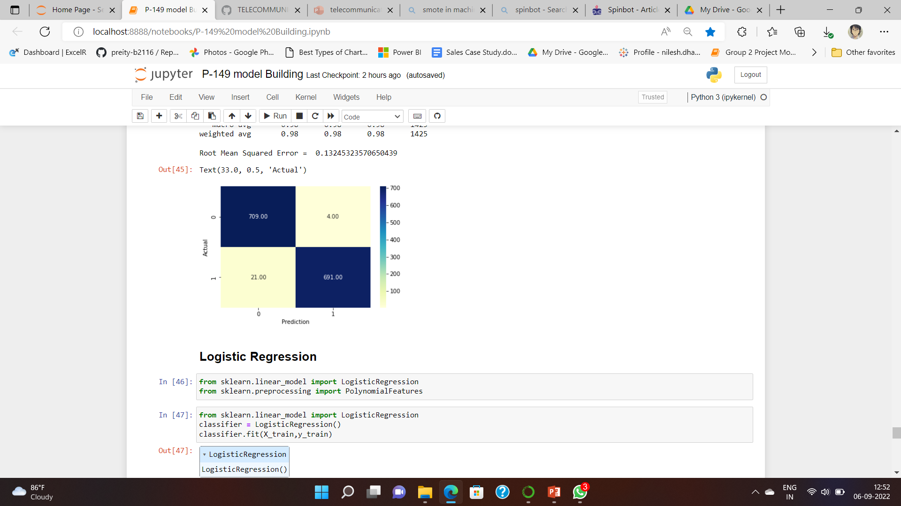
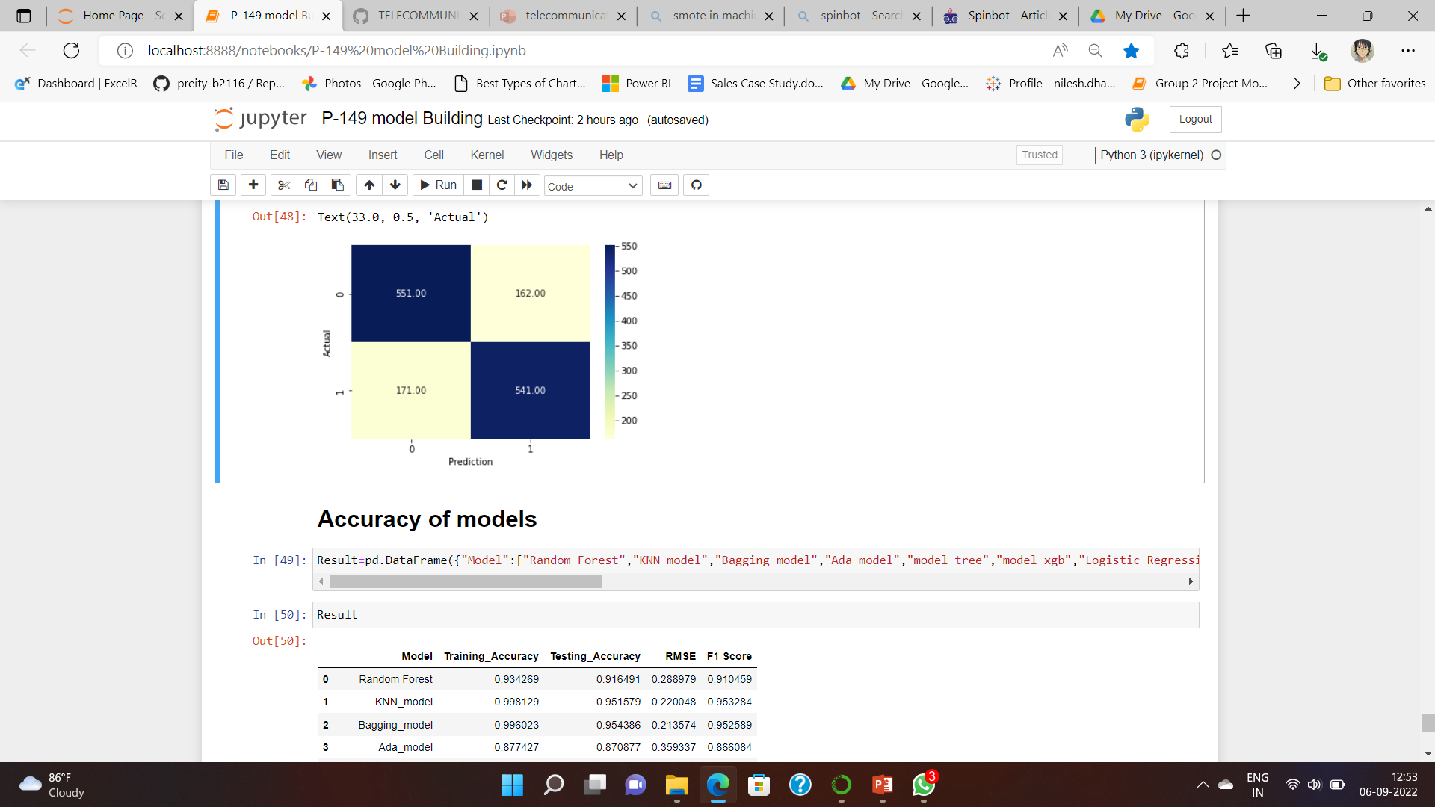
Ada-Boost
Decision Tree
XG- Boost
Logistic Regression
As we Can see from all the Matrix XG-Boost is giving best out put.

Slide 48
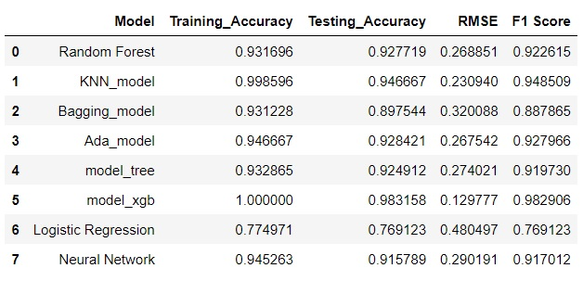
Updated Accuracy Score of Models
-Added Neural Network model
-Used parameters to tune
-We still get the Highest Accuracy in XG-Boost model with 100% in Training And 98.31% in Test

Slide 49




Updated Confusion matrix of Models
Random Forest
KNN
Bagging
ANN

Slide 50




Ada-Boost
Decision Tree
XG- Boost
Logistic Regression
As we Can see from all the Matrix XG-Boost is giving best out put.

Slide 51
ROC- Receiver Operating Characteristic
ROC stands for Receiver Operating Characteristic. ROC curves are a convenient visual tool for analyzing two or more classification models. It displays the trade-off among the true positive rate or sensitivity (proportion of positive tuples that are recognized) and the false-positive rate (proportion of negative tuples that are incorrectly recognized as positive) for a given model.

Slide 52

ROC CURVE VALUE

Slide 53
Deplyoment using Streamlit
Streamlit is an open-source python framework for building web apps for Machine Learning and Data Science. We can instantly develop web apps and deploy them easily using Streamlit. Streamlit allows you to write an app the same way you write a python code. Streamlit makes it seamless to work on the interactive loop of coding and viewing results in the web app.

Slide 54
Features
Churn Prediction
Probability

Slide 55

If person is going to churn out and value is 1

Slide 56

If person will not churn and value is 0

Slide 57
Challanges
-Understanding relationship between data
-Balancing Highly imbalnced data
-Improving accuracy
-Deployment

